Slide 1
Infrastructure Types – Traditional
A traditional infrastructure is built out of individual units; separate storage, application servers, networking and backup appliances that are interlinked
Each unit must be configured individually
Each component is managed individually; usually, that requires a team of IT experts, each specialized in a different field
Sometimes, each unit comes from a different vendor, therefore support and warranty are managed individually
Traditional infrastructures are still a good fit for companies with a stable environment that handle very large deployments, thousands of applications, many, many users, as well as a dedicated IT staff with specializations in different datacenter fields. Think huge datacenters and large multi-national companies
Here Each component is managed individually, like Window system is managed by windows team, Network is managed by networking team(compute network storage and db are individual entity.)

Slide 2
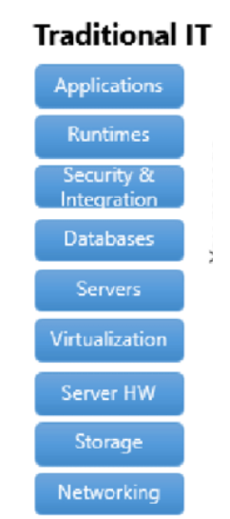
Traditional IT System

Slide 3
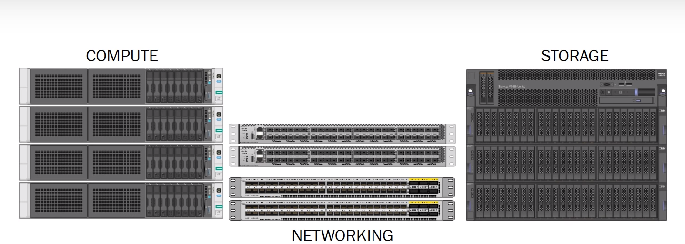
Infrastructure Types – Traditional
Compute → VMWare
Networking → Cisco
Storage → IBM SAN

Slide 4
Infrastructure Types – Converged
Application servers, storage, and networking switches are sold as a single turn-key solution by a vendor
The entire product stack is pre-configured for a certain workload; however, it does not offer a lot of flexibility to adapt for workload changes
As in the case of traditional infrastructures, more challenging hardware issues may have to be handled by different providers
Every appliance in the converged stack needs to be managed separately in most cases
Converged infrastructures are ideal for companies that need a lot of control over each element in their IT infrastructure, as each element can be “fine-tuned” individually.
They may also be a good fit for large enterprises who are replacing their entire infrastructure, as they do not need to browse the market and purchase every component separately.

Slide 5
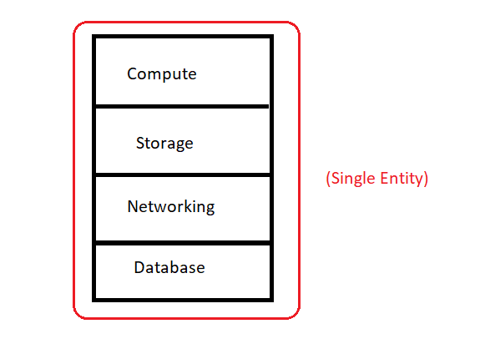
Infrastructure Types – Converged

Slide 6
Example
Laptop/Desktop

Slide 7
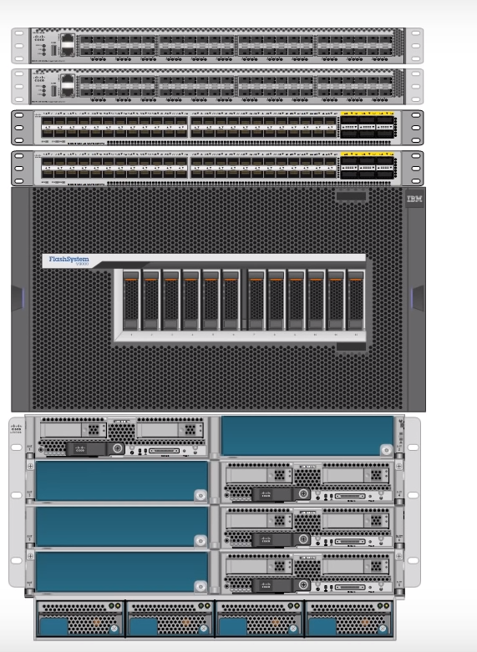
Infrastructure Types – Converged
The picture here shows a cisco converged solution.
Its a Virtual stack which contains cisco switching and blade server
and IBM Flash storage.
The management of these systems are done from single interface

Slide 8
Infrastructure Types – Hyper-Converged
Storage, networking and compute are combined in a single unit that is centrally managed and purchased from a single vendor
All the technology are integrated, and it takes less time to configure the whole solution
The software layer gives you flexibility in using hardware resources and makes the deployment and management of VMs easy
Small and medium enterprises which require a cost-effective, flexible and agile infrastructure that can be managed by 1-2 IT people.
Here all the things are managed by single console(Example- AWS console)

Slide 9
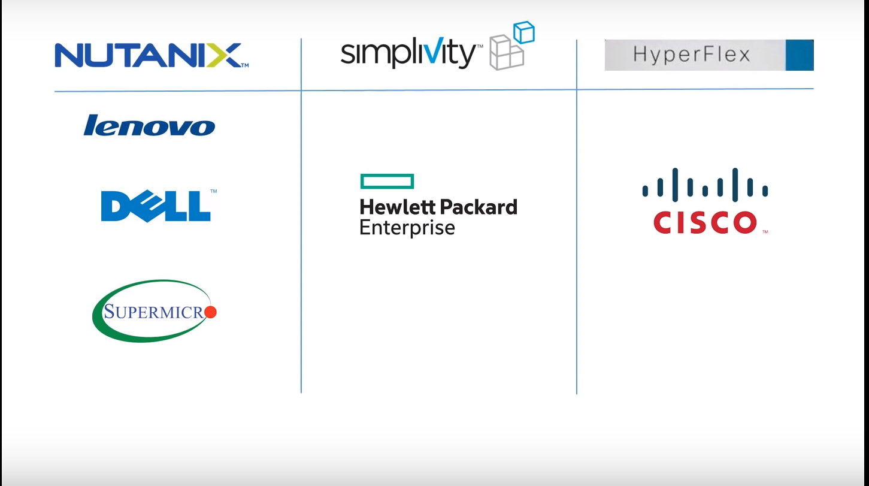
Infrastructure Types – Hyper-Converged

Slide 10
Infrastructure Types – Hyper-Converged
Advantages of hyper-converged infrastructures
Simplified management: a hyper-converged infrastructure unifies management in a single simple interface, allowing the rest of your IT team to focus on proactive parts of the business.
Reduced costs and increased efficiency: lower costs of purchasing and management are achieved; they can go as far as 50% lower.
Increased agility and faster deployment allows much faster deployment of new infrastructure for new business applications.
Data protection: improved data protection mechanisms thanks to the tight integration of components.

Slide 11
Infrastructure Types – Conclusion
To sum things up, the size and needs of your business are to be taken into consideration when choosing a new infrastructure:
If you have a very stable environment, a low turnover, a specialized IT staff and you also need ultra-high performance (1.000.000 IOPS), then a traditional infrastructure will work for you.
If you need the performance and control of a traditional infrastructure but are deploying from scratch, choose a converged infrastructure to avoid the costs and troubles of hunting for many pieces of infrastructure from different vendors.
If your business needs fast deployment, quick access to resources and a low foot print while keeping your overall IT budget low, then a hyper-converged infrastructure is the best for you.

